Slide 1
Priority Setting for Health Care Performance Measurement: Addressing Performance Measure Gaps in Priority Areas
Adult Immunization Committee In-Person Meeting
March 31-April 1, 2014

Slide 2
Welcome and Introductions

Slide 3
Multistakeholder Committee
Amir Qaseem (Co-Chair), American College of Physicians | Caroline Johnson, Philadelphia Department of Public Health
Ernest Moy (Co-Chair), Agency for Healthcare Research and Quality | Megan Lindley, Centers for Disease Control and Prevention
Roger Baxter, Kaiser Permanente Vaccine Study Center | James McCabe, Safeway Pharmacy
Howard Bregman, Epic | David Nace, University of Pittsburgh Institute on Aging
Eddy Bresnitz, Merck Vaccines | Patricia Nuzzie, The Immunization Project
Jeffrey Duchin, Communicable Disease Control, Seattle & King County | Laura Riley, Massachusetts General Hospital
Jennifer Heath, Minnesota Dept. of Health | Douglas Shenson, Yale University School of Medicine
Robert Hopkins, University of Arkansas for Medical Sciences | Sandra Sommer, Virginia Department of Health
Joseph Hunter, Methodist-Le Bonheur Healthcare | Samuel Stolpe, Pharmacy Quality Alliance
Janet Jennings, Blue Care Network | Litjen (L.J.) Tan, Immunization Action Coalition

Slide 4
Priority Setting for Health Care Performance Measurement: 2013-14 Focus Areas
Adult Immunizations
Alzheimer’s Disease and Related Dementias
Care Coordination
Health Workforce
Person-Centered Care and Outcomes

Slide 5
Adult Immunization Project
Provide multi-stakeholder guidance on the highest priorities for measurement to optimize vaccination rates and outcomes across adult populations
Project will entail:
Literature review and environmental scan of measures
Development/refinement of a conceptual model
Measure gap analysis
Written report of recommendations for high-leverage opportunities and next steps for measure development and endorsement

Slide 6
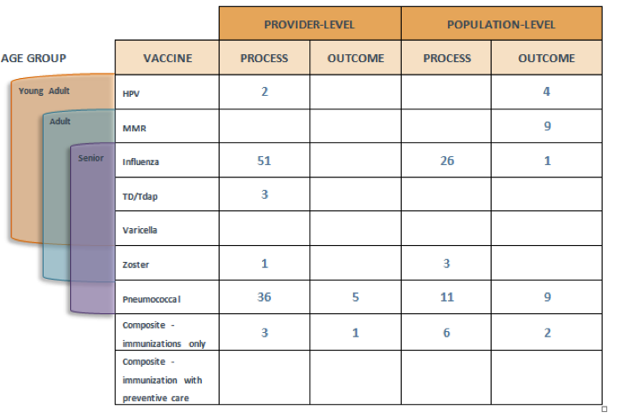
Draft Conceptual Framework

Slide 7
 |  | PROVIDER-LEVEL |  | POPULATION-LEVEL
SPECIAL POPULATIONS | VACCINE | PROCESS | OUTCOME | PROCESS | OUTCOME
Maternity | Influenza | 1 |  | 3
 | Tdap
 | Composite
Diabetes | Influenza | 3
 | Pneumococcal | 1
 | Hepatitis B
 | Composite
 | General | 1
Chronic liver disease | Hepatitis A and B | 6 |  | 1 | 6
 | Composite
Heart disease, chronic lung disease, chronic alcoholism | Influenza | 4
 | Pneumococcal | 2
 | Composite | 1
Community Aquired Pneumonia | Influenza | 4 | 1
Kidney failure, ESRD, dialysis | Influenza | 6
 | Pneumococcal | 2
 | Hepatitis B | 1 |  | 1
 | Composite
Immunocompromised (except HIV) | Influenza | 1
 | Td/Tdap
 | HPV
 | Pneumococcal
 | Composite | 2
HIV/AIDS | Influenza | 2
 | Pneumococcal | 2
 | Hepatitis B | 6
 | Other Infections Disease | 1
 | Composite
MSM | Hepatitis A and B |  |  | 1 | 2
 | Compisite

Slide 8
HEALTHCARE PERSONNEL | EMPLOYER/FACILITY – LEVEL |  | POPULATION - LEVEL
VACCINE | PROCESS | OUTCOME | PROCESS | OUTCOME
Influenza | 7
Hepatitis B |  |  | 2
Tdap
MMR
Varicella
Zoster
Composite
IMMUNIZATION INFORMATION SYSTEMS (IIS)
PROVIDER-LEVEL | SYSTEM-LEVEL
3 | 4

Slide 9
Draft Environmental Scan Findings to Date
225 measures identified as relevant to Adult Immunization
Seventy nine measures (35 %) address influenza immunization
Pneumococcal immunization is the second largest group with 60 measures (26 %)
The majority of measures for all vaccines are process measures (69%)
Only four of the 46 outcome measures are at the provider level – the majority are population surveillance measures
Fifteen composite measures provide examples of how measures can be combined
The composites include both measures that combine only immunizations as well as composites that include immunizations with other preventive services

Slide 10
Key Informant Interviews
Andrew Baskin, America’s Health Insurance Plans (AHIP)
Lee Partridge, National Partnership for Women and Families
Sepheen Byron, National Committee for Quality Assurance (NCQA)
Senka Hadzic, Institute for Clinical Systems Improvement (ICSI)
Amy Groom, Indian Health Services (IHS)
Troy Knighton et al, Veterans Administration (VA)
Gary Urquhart, Centers for Disease Control & Prevention (CDC)
Jim Daniels et al, HHS Office of the National Coordinator for Health Information Technology (ONC)
Howard Bregman, EPIC
Karen Nielsen et al, Siemens Medical Solutions

Slide 11
Overview of Project Timeline
June 23-July 14
Public comment period on report recommendations
June 26
Public webinar to solicit feedback on report recommendations
Aug 15
Final report submitted to HHS
Mar 31 –
April 1
Committee in-person meeting to obtain multi-stakeholder recommendations to address priorities for measure development

Slide 12
Adult Immunization In-Person Meeting Objectives
Prioritize measurement gaps for adult immunization using the conceptual model
Identify key leverage points and other measurement considerations for adult immunization performance measurement
Recommend measure and measure concept development for the short- and long-term

Slide 13
Current Use of Measurement for
Adult Immunization

Slide 14
Why measure?
Not everything that counts can be counted, and not everything that can be counted counts
~Albert Einstein
B but… what gets
measured gets done!

Slide 15
Applications of Performance Measures
Accountability
Quality
Improvement
Professional
Certification
Accreditation
HIT Incentives
Payment
Public Reports
Transparency

Slide 16
Healthy People 2020
IID 4.2 Reduce new invasive pneumococcal infections among adults 65 years and older
IID-13 Increase the percentage of adults who are vaccinated against pneumococcal disease
IID-12 Increase the percentage of children and adults who are vaccinated annually against seasonal influenza
IID-14 Increase the percentage of adults vaccinated against zoster
IID- 15.3 Increase hepatitis B coverage among healthcare personnel.
IID- 25.1 Reduce new hepatitis B infections in adults 19+ years
IID- 23 Reduce Hepatitis A

Slide 17
CDC MMWR Feb 7, 2014 Non-influenza Vaccination Coverage Among Adults — United States, 2012
Adult vaccination (NHIS) | 2012 rate
Pneumococcal vaccination age 19-64 years high risk | 20%
> 65 years | 59.9%
Tetanus vaccination in past 10 years 19-49 years | 64.2%
50-64 years | 63.5%
>65 years | 55.1%
Tetanus vaccination with pertussis >19 years | 14.2%
living with infant < 1 yr | 25.9%
Hepatitis A vaccination 19-49 years | 12.2%
Hepatitis B vaccination in patients with diabetes | 28.6%
Zoster vaccination >60 years | 20.1%
HPV vaccination females 19-26 years | 34.5%

Slide 18
2012 National Healthcare Quality Report
Adults age 65 and over who reported having influenza vaccination in the past
12 months, 2010

Slide 19
Commonwealth Fund www.whynotthebest.org
Aggregate hospital reports

Slide 20
Expanded BRFSS

Slide 21
Expanded BRFSS

Slide 22
NCQA State of Quality 2013 HEDIS measures for Health Plans using CAHPS patient survey

Slide 23
Influenza HEDIS measure over time

Slide 25
Influenza vaccination for Healthcare Personnel
Beginning Jan 1, 2013 acute care hospitals are required to report data to NHSN for the entire flu season (Oct 1 to March 31) for the Inpatient Quality Reporting (IQR) program
Hospital outpatient reporting (OQR), ), long-term acute care facilities (LTCHQR), IRFs, Ambulatory Surgical Centers begins October 2014
Hospital-specific HCP influenza vaccination summary data reported to NHSN will be reported by CDC to CMS on May 15
Public reporting of the data from acute care hospitals will begin with the 2013-2014 flu season.

Slide 28
HRSA Clinical Core Set of Measures
Adult Influenza Vaccination Percentage of patients 50 to 64 years of age who have received an influenza vaccine during flu season
Older Adult Influenza Vaccination Percentage of patients 65 years and older who have received influenza vaccine during flu season
Older Adult Pneumococcal Immunization Percentage of patients 65 and above who have ever received pneumococcal vaccine
Hepatitis B Vaccine for HIV+ patients Percentage of patients with HIV infection who completed the vaccination series for Hepatitis B

Slide 29
2014 Medicaid Core Sets of Measures
ADULT (26 measures)
Flu Vaccinations for Adults Ages 18 to 64 (NCQA)
CHILD HEALTH (23 measures)
Childhood Immunization Status
Immunization Status for Adolescents
Human Papillomavirus (HPV) Vaccine for Female Adolescents

Slide 30
Meaningful Use of Health Information Technology Incentive Program
Incentives for eligible providers and eligible hospitals
MU requirements for immunization
Stage 1
test, and if successful, establish a connection from the EHR to the IIS in the provider’s jurisdiction
Stage 2
endorsement of a single standard, HL7 2.5.1, for all immunization messages submitted from EHR systems to IIS, and the requirement for “ongoing submission” of production immunization data (as opposed to test data) to an IIS
Stage 3 (draft)
likely to enhance functionality to permit clinicians to view the entire immunization registry/immunization information system record and support bi-directional information exchange

Slide 32
Initial Prioritization Results

Slide 34
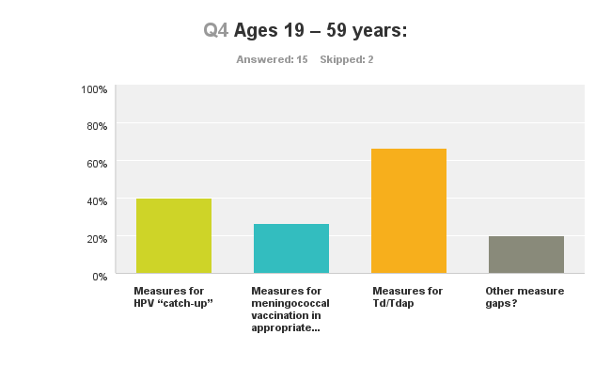

Slide 35
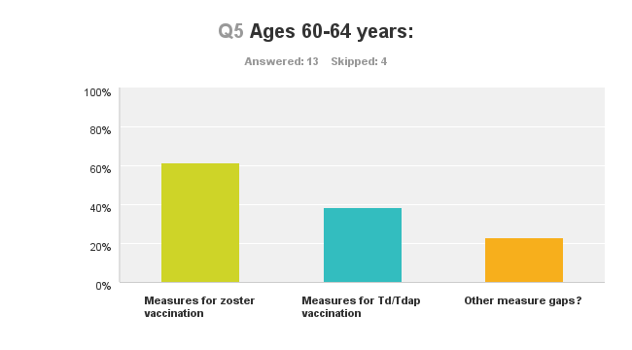

Slide 36
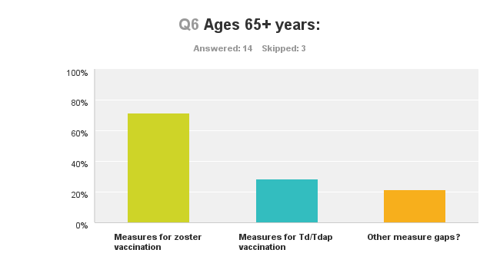

Slide 37
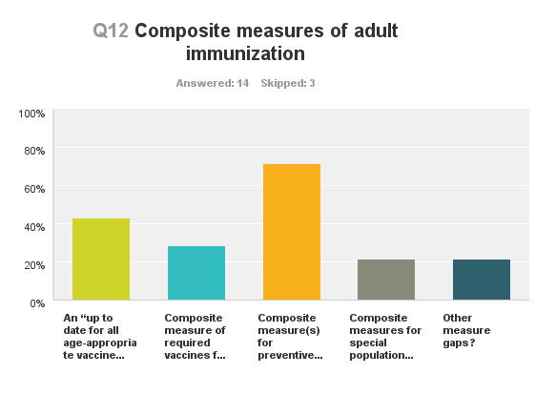

Slide 38
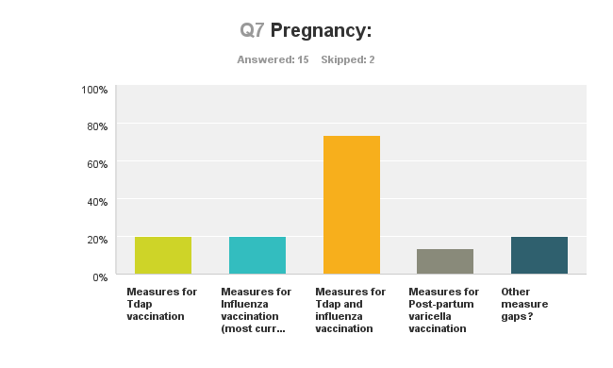

Slide 39
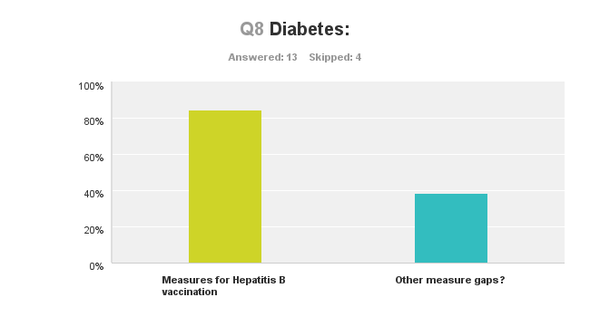

Slide 40
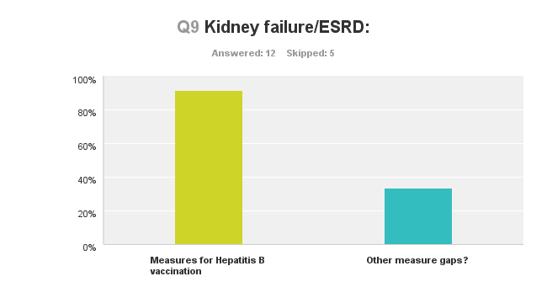

Slide 41
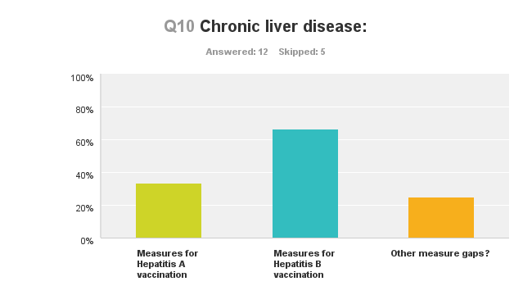

Slide 42
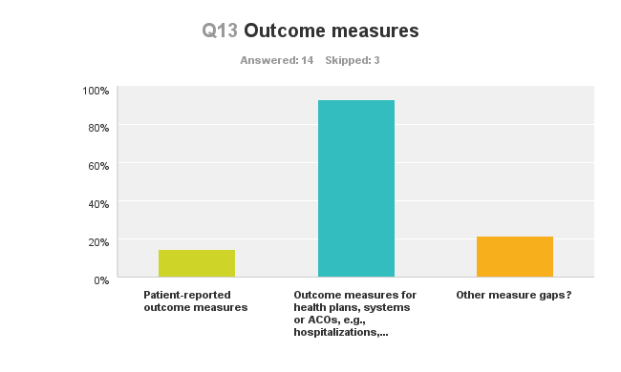

Slide 43
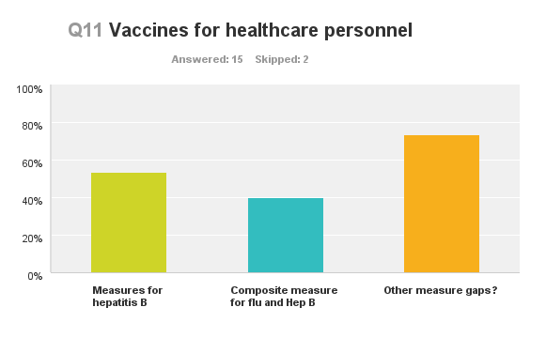

Slide 44
Additional Considerations for Adult Immunization Performance Measurement

Slide 45
Data sources for measurement
Availability and quality of data
Surveys
Administrative data (medical claims, pharmacy claims)
Patient medical records
Paper
EHRs
Other electronic databases
Immunization information systems/registries

Slide 46
IIS and registries
IIS’s are a nationwide network of systems – not a national system
IIS variable among the states – many not actively tracking adults
IIS infrastructure or capability is mostly there to capture adults
Expanding to adults
Meaningful Use program – more attention on adults
More vaccines for adults
Non-traditional providers providing data
Walgreens reports adult immunization data in 40 states
Children aging into adults
MU has helped to standardize EHRs and reporting elements
All but 3 states are “opt out” for reporting pediatric immunization

Slide 47
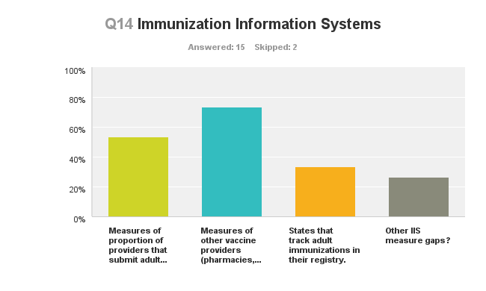

Slide 48
Disparities

Slide 49
Harmonization
2008 NQF report “National Voluntary Consensus Standards for Influenza and Pneumococcal Immunizations”
Goal: a single global measure that applies to all settings and providers and settings of care
“Multiple measures with essentially the same focus create confusion in choosing measures for implementation and interpreting results. Differences in measure specifications limit comparability and understanding of results across settings and/or patient populations.”
Harmonization aligns the measure construct and specifications

Slide 50
Comparison of different approaches
 | Provider 1 100 patients | Provider 2 100 patients
1. Score includes assessed but not given due to decline or contraindication | 82% | 82%
2. Numerator categories | Received vaccine – 50% Declined - 27% Contraindications -5% | Received vaccine – 70% Declined – 10% Contraindications – 2%
3. Score using denominator exclusions for decline and contraindications | 50/100-32 = 73.5% | 70/100-12 = 79.5%

Slide 51
Measurement burden
Burden - While crucial to improving healthcare quality, measurement can have a downside: it takes a lot of hard work! Measurement burden can be the result of a number of factors, including costs and time associated with increased, duplicative, or labor-intensive data collection, analysis, or reporting.

Slide 52
Key Leverage Points Discussion

Slide 53
Opportunity for Public Comment

Slide 54
Lunch Break
Committee to resume at 1pm ET

Slide 55
Considerations for Adult Immunization Performance Measurement

Slide 56
Opportunity for Public Comment

Slide 57
Break
Committee to resume at 4pm ET

Slide 58
Priorities Identified To-Date
Measures for zoster and Td/Tdap vaccination
Measures for Td/Tdap for ages 19-59
Measures for zoster for ages 60-64 and ages 65+
Measures for Tdap and influenza vaccination for the pregnant population
Measures for Hepatitis B vaccination for the diabetic and those with kidney failure/ESRD and chronic liver disease
Outcome measures for health plans, systems, or ACOs

Slide 59
Measure Gaps Prioritization

Slide 60
DAY 2

Slide 61
Results of Day 1 Prioritization

Slide 62
Additional Considerations for Priorities in Measure Gaps

Slide 63
Report Out From Small Groups

Slide 64
Opportunity for Public Comment

Slide 65
Lunch Break
Committee to resume at 12:45pm ET

Slide 66
Round-Robin Discussion of Recommendations to HHS

Slide 67
Opportunity for Public Comment

Slide 68
Next Steps
Draft Report to HHS on June 16
Public comment period on draft report – June 23-July 14
Public webinar on project findings – June 26, 2-4pm ET
Final report due to HHS in August 15, 2014

Slide 69
For More Information
http://www.qualityforum.org/projects/prioritizing_measures/adult_immunization/
Reva Winkler Juliet Feldman
rwinkler@qualityforum.org jfeldman@qualityforum.org

Slide 70
Thank you for joining us

